Slide 1

Exercises
Let us practice the concepts learned by solving some problems.

Slide 2
Problem Statement
  Write the pseudocode to accept a number and then find out whether or not the number is divisible by five.
  Allocated time to solve the problem is 10 minutes.
Notes:
Explain the meaning of pseudocode. Using the example of adding two numbers explain how easily an pseudocode can be rewritten to program using a specific programming language.

Slide 3
Problem Statement (Contd.)
Answer the following questions:
  How many variables are required to solve the given problem?
  What type of variables you will declare?
  What is the expected output?
Notes:
Explain the concept of dry run. Tell that it will help to know the output of a program by taking sample values.

Slide 4



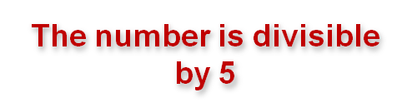
Solution
Let us see the dry run of the pseudocode.
begin
    numeric nNum
    display ‘Enter a number’
    accept nNum
    if (nNum % 5 == 0)
    begin
    display ‘The number
    is divisible by 5’
    end
    else
    begin
    display ‘The number
    is not divisible by 5’
    end
  end
nNum
Notes:
Explain the meaning of pseudocode. Using the example of adding two numbers explain how easily an pseudocode can be rewritten to program using a specific programming language.

Slide 5




Solution (Contd.)
Let us see the dry run of the pseudocode with another value.
begin
    numeric nNum
    display ‘Enter a number’
    accept nNum
    if (nNum % 5 == 0)
    begin
    display ‘The number
    is divisible by 5’
    end
    else
    begin
    display ‘The number
    is not divisible by 5’
    end
  end
nNum
Notes:
Explain the meaning of pseudocode. Using the example of adding two numbers explain how easily an pseudocode can be rewritten to program using a specific programming language.

Slide 6
Problem Statement
  Write the pseudocode to accept three numbers and display the largest number.
  Allocated time to solve the problem is 10 minutes.
Notes:
Explain the meaning of pseudocode. Using the example of adding two numbers explain how easily an pseudocode can be rewritten to program using a specific programming language.

Slide 7
Problem Statement (Contd.)
Answer the following questions:
  How many variables are required to solve the given problem?
  What type of variables you will declare?
  What is the expected output?
Notes:
Explain the concept of dry run. Tell that it will help to know the output of a program by taking sample values.

Slide 8
Solution
  begin
  numeric nNum1, nNum2, nNum3
  display ‘Enter three numbers’
  accept nNum1, nNum2, nNum3
  if ((nNum1 > nNum2) AND
  (nNum1 > nNum3))
  begin
  display nNum1 ‘is the
  largest number’
  end
Notes:
Explain the meaning of pseudocode. Using the example of adding two numbers explain how easily an pseudocode can be rewritten to program using a specific programming language.

Slide 9
Solution (Contd.)
  else
  begin
  if ((nNum2 > nNum1) AND
  (nNum2 > nNum3))
  begin
  display nNum2 ‘is the largest number’
  end
  else
  begin
  display nNum3 ‘is the largest number’
  end
  end
  end
Notes:
Explain the meaning of pseudocode. Using the example of adding two numbers explain how easily an pseudocode can be rewritten to program using a specific programming language.

Slide 10




Solution (Contd.)
Let us see the dry run of the pseudocode.
  begin
  numeric nNum1, nNum2, nNum3
  display ‘Enter three numbers’
  accept nNum1, nNum2, nNum3
  if ((nNum1 > nNum2) AND
  (nNum1 > nNum3))
  begin
  display nNum1 ‘is the
  largest number’
  end
nNum1
nNum2
nNum3
Notes:
Explain the meaning of pseudocode. Using the example of adding two numbers explain how easily an pseudocode can be rewritten to program using a specific programming language.

Slide 11




Solution (Contd.)
nNum1
nNum2
nNum3
  else
  begin
  if ((nNum2 > nNum1) AND
  (nNum2 > nNum3))
  begin
  display nNum2 ‘is the
  largest number’
  end
  else
  begin
  display nNum3 ‘is the
  largest number’
  end
  end
  end
Notes:
Explain the meaning of pseudocode. Using the example of adding two numbers explain how easily an pseudocode can be rewritten to program using a specific programming language.

Slide 12
Problem Statement
  Write the pseudocode to accept the age of a candidate. If the age entered is 18 or above, a message should be displayed “You are eligible to vote”. If the age entered is below 18, a message should be displayed “You are not eligible to vote”.
  Allocated time to solve the problem is 10 minutes.
Notes:
Explain the meaning of pseudocode. Using the example of adding two numbers explain how easily an pseudocode can be rewritten to program using a specific programming language.

Slide 13
Problem Statement (Contd.)
Answer the following questions:
  How many variables are required to solve the given problem?
  What type of variables you will declare?
  What is the expected output?
Notes:
Explain the concept of dry run. Tell that it will help to know the output of a program by taking sample values.

Slide 14



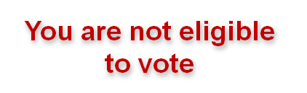
Solution
Let us see the dry run of the pseudocode.
  begin
  numeric nAge
  display ‘Enter your age’
  accept nAge
  if nAge < 18
  begin
  display ‘You are not
  eligible to vote’
  end
  else
  begin
  display ‘You are
  eligible to vote’
  end
  end
nAge
Notes:
Explain the meaning of pseudocode. Using the example of adding two numbers explain how easily an pseudocode can be rewritten to program using a specific programming language.

Slide 15


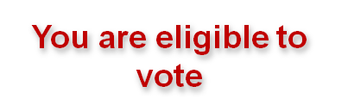
Solution (Contd.)
Let us see the dry run of the pseudocode with another value.
  begin
  numeric nAge
  display ‘Enter your age’
  accept nAge
  if nAge < 18
  begin
  display ‘You are not
  eligible to vote’
  end
  else
  begin
  display ‘You are
  eligible to vote’
  end
  end
nAge
Notes:
Explain the meaning of pseudocode. Using the example of adding two numbers explain how easily an pseudocode can be rewritten to program using a specific programming language.

Slide 16
Problem Statement
  Write the pseudocode to accept two numbers and display the quotient as a result. In addition, an error message should be displayed if the second number is zero or is greater than the first number.
  Allocated time to solve the problem is 10 minutes.
Notes:
Explain the meaning of pseudocode. Using the example of adding two numbers explain how easily an pseudocode can be rewritten to program using a specific programming language.

Slide 17
Problem Statement (Contd.)
Answer the following questions:
  How many variables are required to solve the given problem?
  What type of variables you will declare?
  What is the expected output?
Notes:
Explain the concept of dry run. Tell that it will help to know the output of a program by taking sample values.

Slide 18
Solution
  begin
  numeric num1, num2, result
  display ‘Enter two numbers’
  accept num1, num2
  if num2!= 0
  begin
  if num2 < num1
  begin
    result = num1 / num2
    display result
  end
  else
  begin
  display ‘A number cannot
  be divided by a number
  greater than itself’
  end
Notes:
Explain the meaning of pseudocode. Using the example of adding two numbers explain how easily an pseudocode can be rewritten to program using a specific programming language.

Slide 19
Solution (Contd.)
  else
  begin
  display ‘A number cannot be divided
  by zero’
  end
end
Notes:
Explain the meaning of pseudocode. Using the example of adding two numbers explain how easily an pseudocode can be rewritten to program using a specific programming language.

Slide 20





Solution (Contd.)
Let us see the dry run of the pseudocode.
  begin
  numeric num1, num2, result
  display ‘Enter two numbers’
  accept num1, num2
  if num2!= 0
  begin
  if num2 < num1
  begin
  result = num1 / num2
  display result
  end
  else
  begin
  display ‘A number cannot be divided
  by a number greater than itself’
  end
num1
num2
result
2
Notes:
Explain the meaning of pseudocode. Using the example of adding two numbers explain how easily an pseudocode can be rewritten to program using a specific programming language.

Slide 21
Solution (Contd.)
  else
  begin
    display ‘A number cannot be divided
    by zero’
  end
  end
Notes:
Explain the meaning of pseudocode. Using the example of adding two numbers explain how easily an pseudocode can be rewritten to program using a specific programming language.

Slide 22





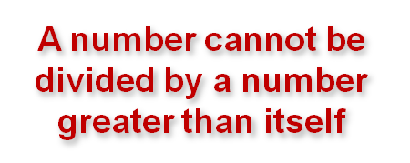
Solution (Contd.)
Let us see the dry run of the pseudocode with another value.
  begin
  numeric num1, num2, result
  display ‘Enter two numbers’
  accept num1, num2
  if num2!= 0
  begin
  if num2 < num1
  begin
    result = num1 / num2
    display result
  end
  else
  begin
  display ‘A number cannot
  be divided by a number
  greater than itself’
  end
num1
num2
Notes:
Explain the meaning of pseudocode. Using the example of adding two numbers explain how easily an pseudocode can be rewritten to program using a specific programming language.

Slide 23
Solution (Contd.)
  else
  begin
    display ‘A number cannot be divided
    by zero’
  end
  end
Notes:
Explain the meaning of pseudocode. Using the example of adding two numbers explain how easily an pseudocode can be rewritten to program using a specific programming language.

Slide 24


Solution (Contd.)
Let us see the dry run of the pseudocode with another set of values.
  begin
  numeric num1, num2, result
  display ‘Enter two numbers’
  accept num1, num2
  if num2!= 0
  begin
  if num2 < num1
  begin
    result = num1 / num2
    display result
  end
  else
  begin
  display ‘A number cannot
  be divided by a number
  greater than itself’
  end
num1
num2
Notes:
Explain the meaning of pseudocode. Using the example of adding two numbers explain how easily an pseudocode can be rewritten to program using a specific programming language.

Slide 25
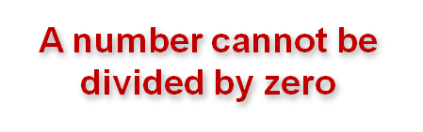
Solution (Contd.)
  else
  begin
  display ‘A number cannot
  be divided by zero’
  end
end
Notes:
Explain the meaning of pseudocode. Using the example of adding two numbers explain how easily an pseudocode can be rewritten to program using a specific programming language.

Slide 26
Problem Statement
  Enter a year and determine whether the year is a leap year or not. A leap year is a non-century year that is divisible by 4. A century year is a year divisible by 100, such as 1900. A century year, which is divisible by 400, such as 2000, is also a leap year. Consider the year entered by a user is either 2000 or 1997.
Notes:
Explain the meaning of pseudocode. Using the example of adding two numbers explain how easily an pseudocode can be rewritten to program using a specific programming language.

Slide 27
Solution
  begin
  numeric nYear
  display ‘Please enter the year’
  accept nYear
  if (nYear % 4 == 0 AND
  (NOT(nYear % 100 == 0)))OR
  (nYear % 400 == 0)
  begin
    display ‘This is a
    leap year’
  end
Notes:
Explain the meaning of pseudocode. Using the example of adding two numbers explain how easily an pseudocode can be rewritten to program using a specific programming language.

Slide 28
Solution (Contd.)
  else
  begin
  display ‘This is not a
  leap year’
  end
end
Notes:
Explain the meaning of pseudocode. Using the example of adding two numbers explain how easily an pseudocode can be rewritten to program using a specific programming language.

Slide 29



Solution (Contd.)
Let us see the dry run of the pseudocode.
  begin
  numeric nYear
  display ‘Please enter the year’
  accept nYear
  if (nYear % 4 == 0 AND
  (NOT(nYear % 100 == 0)))OR
  (nYear % 400 == 0)
  begin
    display ‘This is a
    leap year’
  end
nYear
Notes:
Explain the meaning of pseudocode. Using the example of adding two numbers explain how easily an pseudocode can be rewritten to program using a specific programming language.

Slide 30
Solution (Contd.)
  else
  begin
  display ‘This is not a
  leap year’
  end
end
Notes:
Explain the meaning of pseudocode. Using the example of adding two numbers explain how easily an pseudocode can be rewritten to program using a specific programming language.

Slide 31

Solution (Contd.)
Let us see the dry run of the pseudocode with another value.
  begin
  numeric nYear
  display ‘Please enter the year’
  accept nYear
  if (nYear % 4 == 0 AND
  (NOT(nYear % 100 == 0)))OR
  (nYear % 400 == 0)
  begin
  display ‘This is a
  leap year’
  end
nYear
Notes:
Explain the meaning of pseudocode. Using the example of adding two numbers explain how easily an pseudocode can be rewritten to program using a specific programming language.

Slide 32
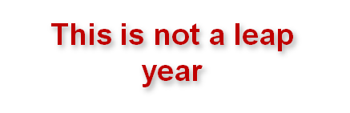
Solution (Contd.)
  else
  begin
  display ‘This is not a
  leap year’
  end
end
Notes:
Explain the meaning of pseudocode. Using the example of adding two numbers explain how easily an pseudocode can be rewritten to program using a specific programming language.

Slide 33
Problem Statement
  Draw a flowchart and write the pseudocode to display the highest of any 10 numbers entered.
Notes:
Explain the meaning of pseudocode. Using the example of adding two numbers explain how easily an pseudocode can be rewritten to program using a specific programming language.

Slide 34


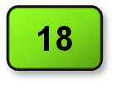

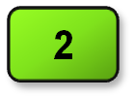
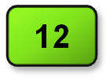
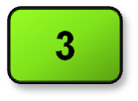
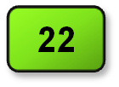

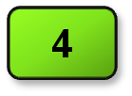
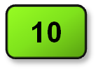
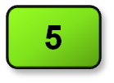
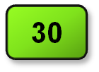

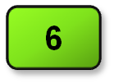
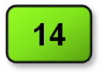

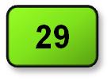

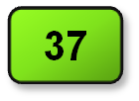

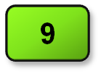
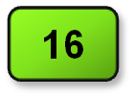

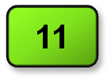
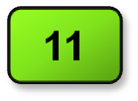
Solution
Start
Let us see the dry run of the flowchart.
nNum
nLarge
nCtr
numeric nNum, nLarge, nCtr
nCtr = 1, nLarge = 0
Accept nNum
Is nNum > nLarge?
No
Yes
nLarge = nNum
nCtr = nCtr + 1
Yes
Is nCtr <= 10?
No
Display nLarge
Stop
Notes:
Explain the meaning of pseudocode. Using the example of adding two numbers explain how easily an pseudocode can be rewritten to program using a specific programming language.

Slide 35
Solution (Contd.)
Let us now see the pseudocode for the flowchart.
begin
numeric nNum, nLarge, nCtr
nCtr = 1, nLarge = 0
for (;nCtr <= 10; nCtr = nCtr + 1)
begin
accept nNum
if nNum > nLarge
begin
nLarge = nNum
end
end
display nLarge
end
Notes:
Explain the meaning of pseudocode. Using the example of adding two numbers explain how easily an pseudocode can be rewritten to program using a specific programming language.

